Slide 1

Data Science Compensation: Navigating Salary Trends for Global Talent
11.22.2024
M. Cristina Fernández
Data Science Project 1 | DSE 5002

Slide 2
We are a rapidly growing company considering hiring a full-time data scientist, with the potential for building a team in the future. Given the economy, trends in salary over time, and variation among data scientist salaries worldwide, it is challenging to determine a fair salary for this potential position.
The purpose of this analysis is to identify a salary range that would attract top talent and remain competitive in the current market.
Notes:
The summary of the question we need to answer.

Slide 3
Key Findings
The average salary of US-based data scientists is higher than that of non-US based (offshore) employees.
Factors such as experience level, employment type, and company size influence salaries.
Salary trends have increased significantly between 2021 and 2022.
There is a salary gap between offshore and US-based employees.

Slide 4
Factors Analyzed
Experience Level
Employment Type
Company Size
Remote Ratio
Employee Residence
Trends over Time
Notes:
So, so many ggplots

Slide 5
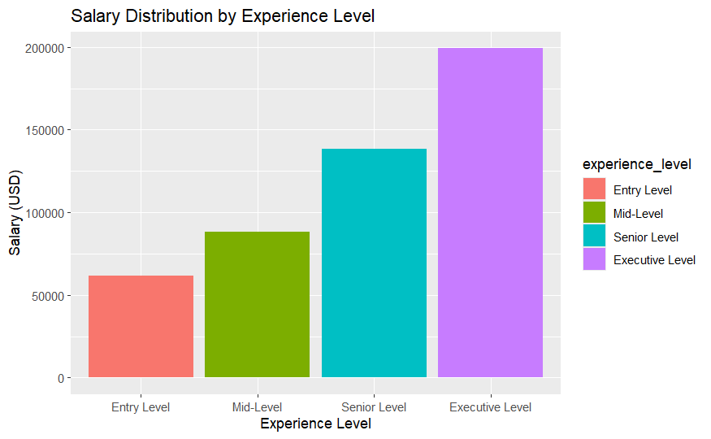
Salary by Experience Level
Fernandez
Data Science Project 1 | DSE 5002
Entry-level salaries are lower (average USD$61.6k), while senior and executive roles command significantly higher salaries (USD$13.8k and USD$19.9k, respectively).
Executive level salaries have a wider range, which could be due to company budgets, years of experience, or additional factors.

Slide 6
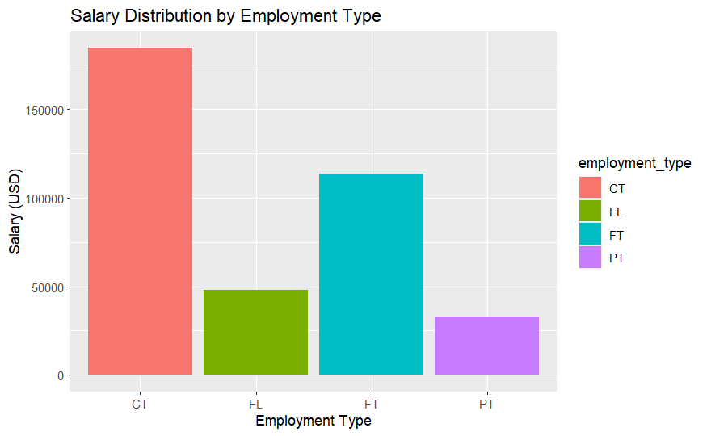
Salary by Employment Type
Full time positions tend to have the highest average salaries.
Contract employees potentially see higher salaries overall, but they typically work shorter-term than a permanent employee and charge high hourly rates. This does not align with what we are hoping to hire for, as our potential new hire would be encouraged to stay and grow the team long-term.
Full time employees average $113,468 per year, and part-timers average $33,070 (though the average number of hours worked is not indicated).

Slide 7
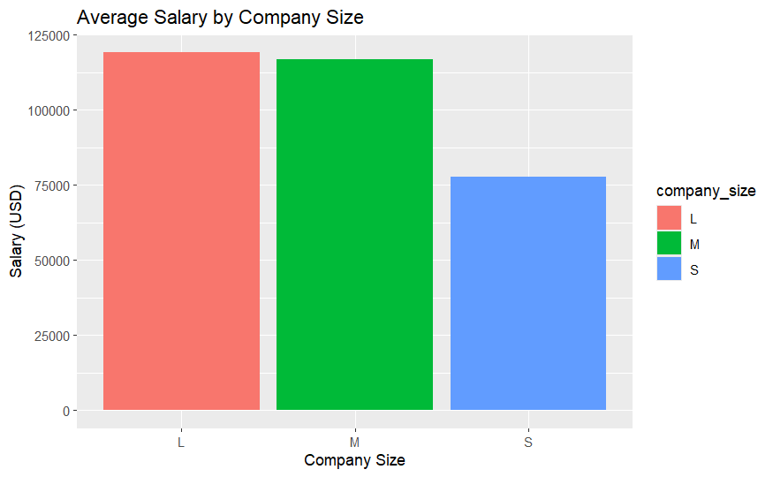
Salary by Company Size
Larger companies tend to offer higher salaries compared to smaller companies, though they are not significantly different than the medium-sized companies.
Small companies may offer lower salaries but could provide other benefits like flexibility or growth opportunities. As our company is small but growing, we can afford to pay slightly higher than the average for a small company ($77,632) but less than a medium company ($116,905).

Slide 8
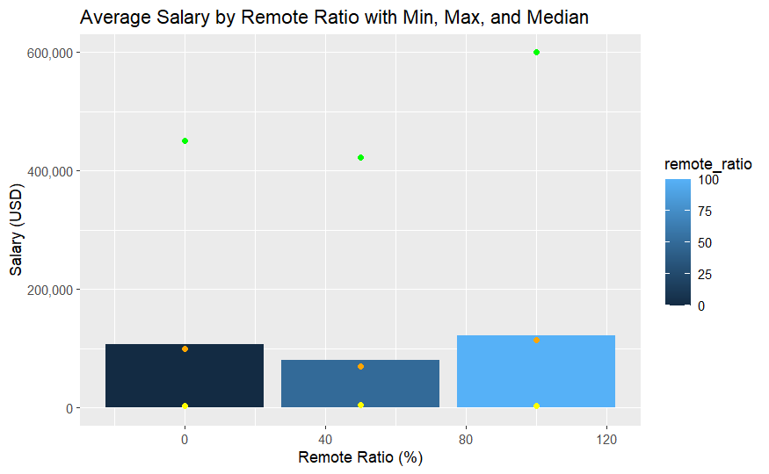
Salary by Remote Work Ratio
These employees, who work entirely on-site (0% remote work), have an average salary of $106,354. Their salaries can range widely, with some having lower minimum salaries and others earning higher maximum salaries.
Employees who work fully remote earn the highest average salary of $122,457. On-site workers have a competitive salary but are more limited by location and availability of talent the area.

Slide 9
Salaries by Location

Slide 10
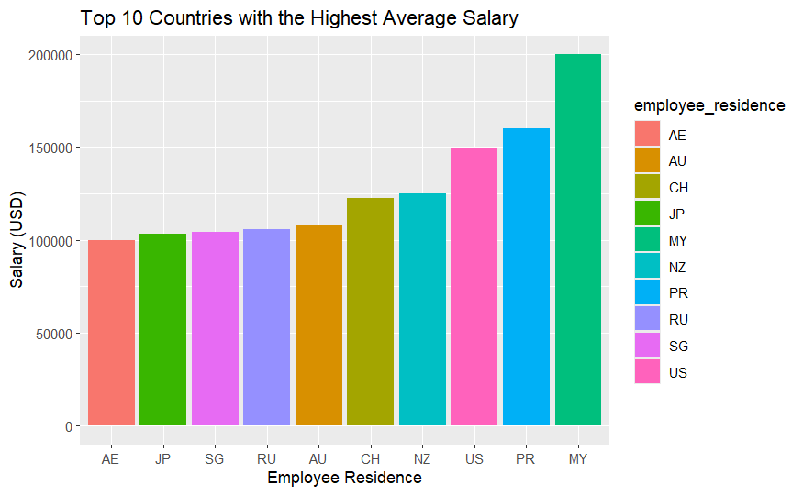
Highest Salaries
The 10 highest paying countries are Malaysia (MY), Puerto Rico (PR), United States (US), New Zealand (NZ), Switzerland (CH), Australia (AU), Russia (RU), Singapore (SG), Japan (JP), and United Arab Emirates (AE)
Malaysia has the top average salary at a reported USD$200k, followed by PR at $160k, and the USA at $149.2k
It is important to note that Malaysia and PR’s data is based on a single employee each, so these may be outliers.

Slide 11
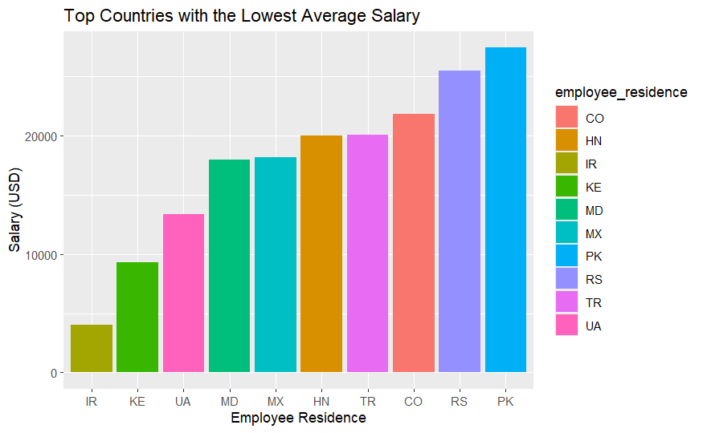
Lowest Salaries
The following chart shows the lowest data science salaries, by contrast. Iran (IR) reports the lowest salary, at USD$4000 based on a single respondent, who is a mid-level full-time Data Engineer. Pakistan (PK) average salary is approximately USD$27.5k

Slide 12
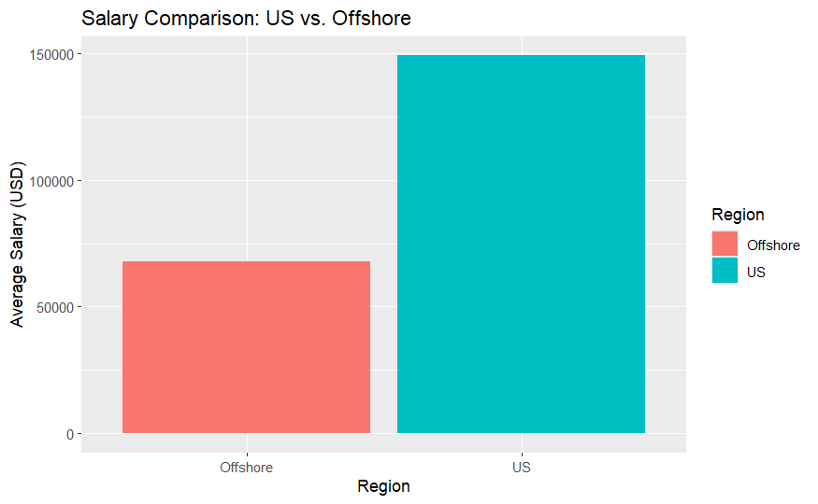
US vs. Offshore
US-based salaries are higher on average (USD$149.2k) compared to offshore locations (overall USD$67.8k)
Offshore workers might provide cost savings, but a lower salary could impact recruitment for top-tier talent.

Slide 13
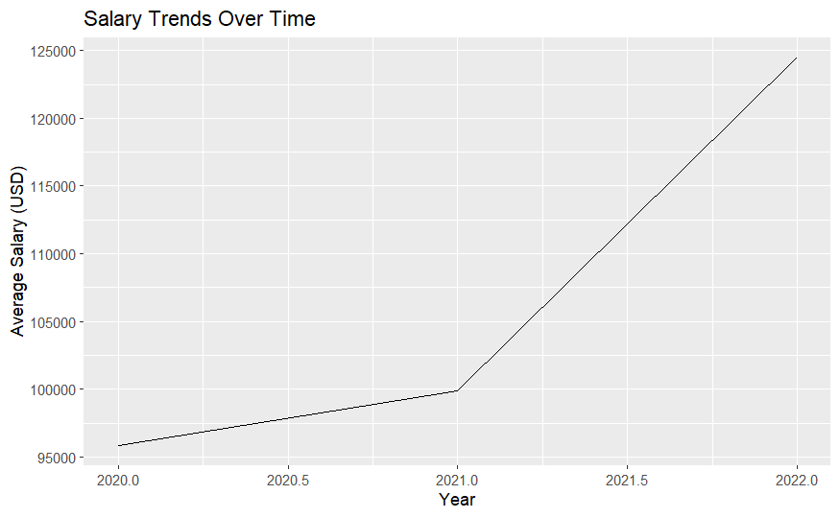
Salary Trends Over Time
Data Science Project 1 | DSE 5002
This chart shows the change in average salaries between 2020 - 2022.
In 2020, the average salary (in USD) for data science professionals was $95,813, increasing to $99,853 in 2021, and yet again increasing to $124,522 in 2022. Overall, this shows an upward trend in salaries over time, with a significant jump in salaries between 2021 and 2022.

Slide 14
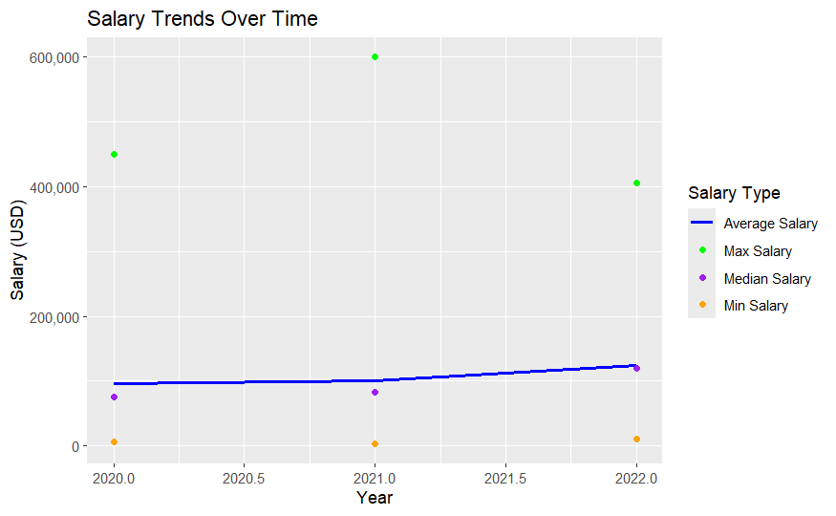
Salary Trends Over Time
This alternative view includes the minimum, maximum, and median salaries overlaid over the average salaries. We still see the jump in overall salary between 2021 and 2022, but the fluctuating maximum salaries are most notable.

Slide 15

Drawing
a Conclusion
Drawing a Conclusion
Data Science Project 1 | DSE 5002
We will look at two more charts that will aggregate some data which will facilitate our decision-making regarding hiring.

Slide 16
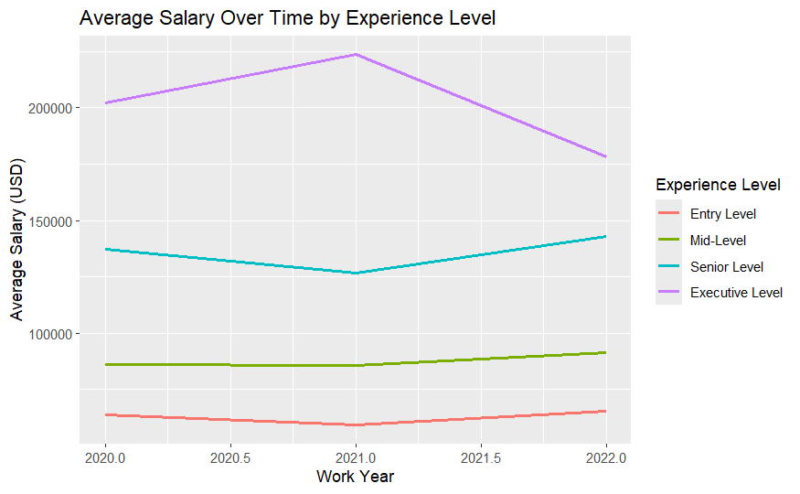
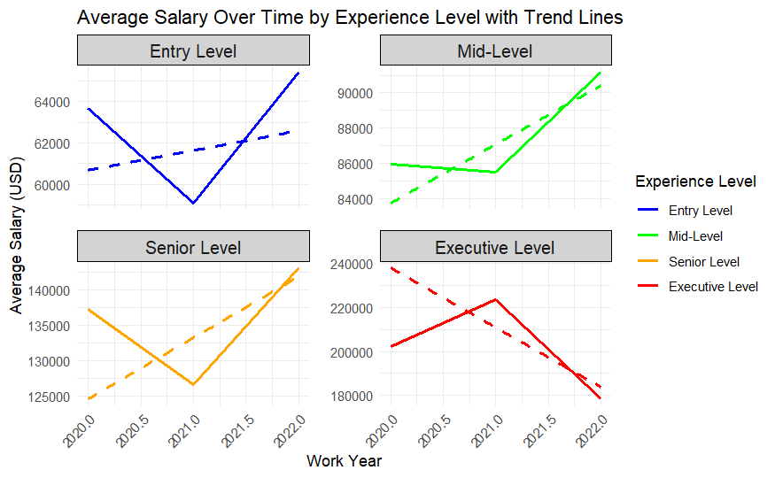
These graphs demonstrate the average salary trends over time (using 2020 - 2022 historical data) broken down by experience level, with the right-hand graph including trend lines.
As we can see, the salaries are trending upwards for all levels of experience except for executive level data science professionals.

Slide 17
Recommendations
Given the increase from $95,813 in 2020 to $124,522 in 2022, we can expect the average salary to continue to rise. With a 30% increase as shown, we can expect that average salaries for 2024 to be between USD$153,000 - USD$182,000.
Remote workers tend to be paid more than others, which, despite being more costly to our company, may be beneficial in that offering remote work would allow us to recruit talent from a broader area. If we consider a remote or hybrid employee that is local to our company HQ, we could offer flexibility in terms of salary without necessarily paying out the much-higher salaries we observe in countries like Malaysia and Puerto Rico.
The most budget-friendly option we can take is to seek a mid-level data science professional who is US-based and willing to work a hybrid schedule.
If our profits and growth are higher than expected, we may be able to broaden our search to senior level professionals and/or offer fully remotes options for work.

Slide 18
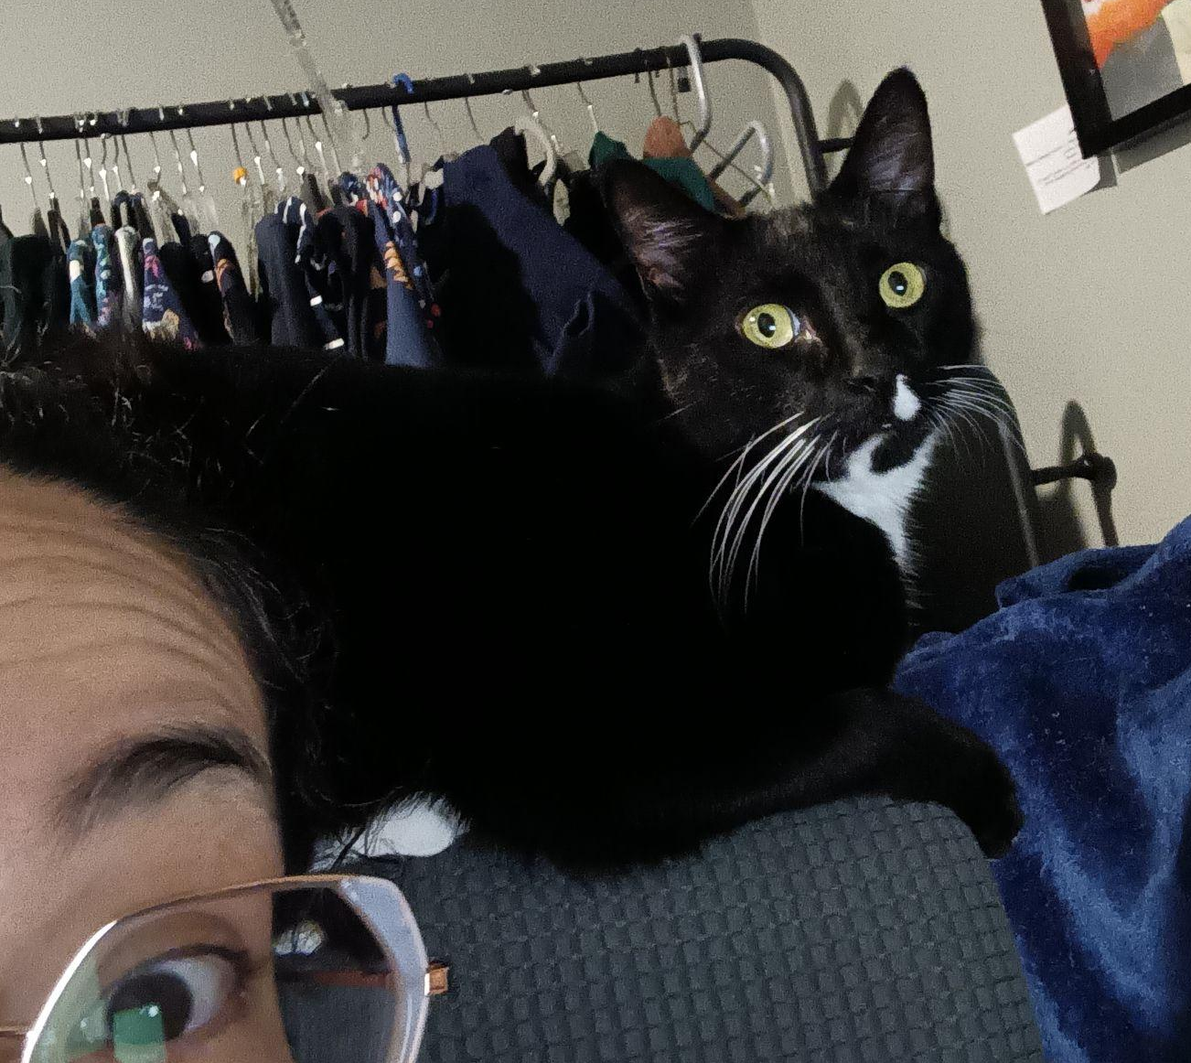
Special thanks
to my (micro)manager, Oskar Wildekat, who watched me code and put together this presentation.

